Slide 1
AI-Powered Accident Cause Identification
Jyothy Das, Jemima IV, Meenu PV

Slide 2
Problem statement
This project aims to analyze accident reports to extract primary cause, secondary cause and risk factors.

Slide 3
Objective
Develop an NLP(natural language processing) based system to identify accident cause from accident report.
Implement a chatbot to extract accident cause from accident report and display it.

Slide 4
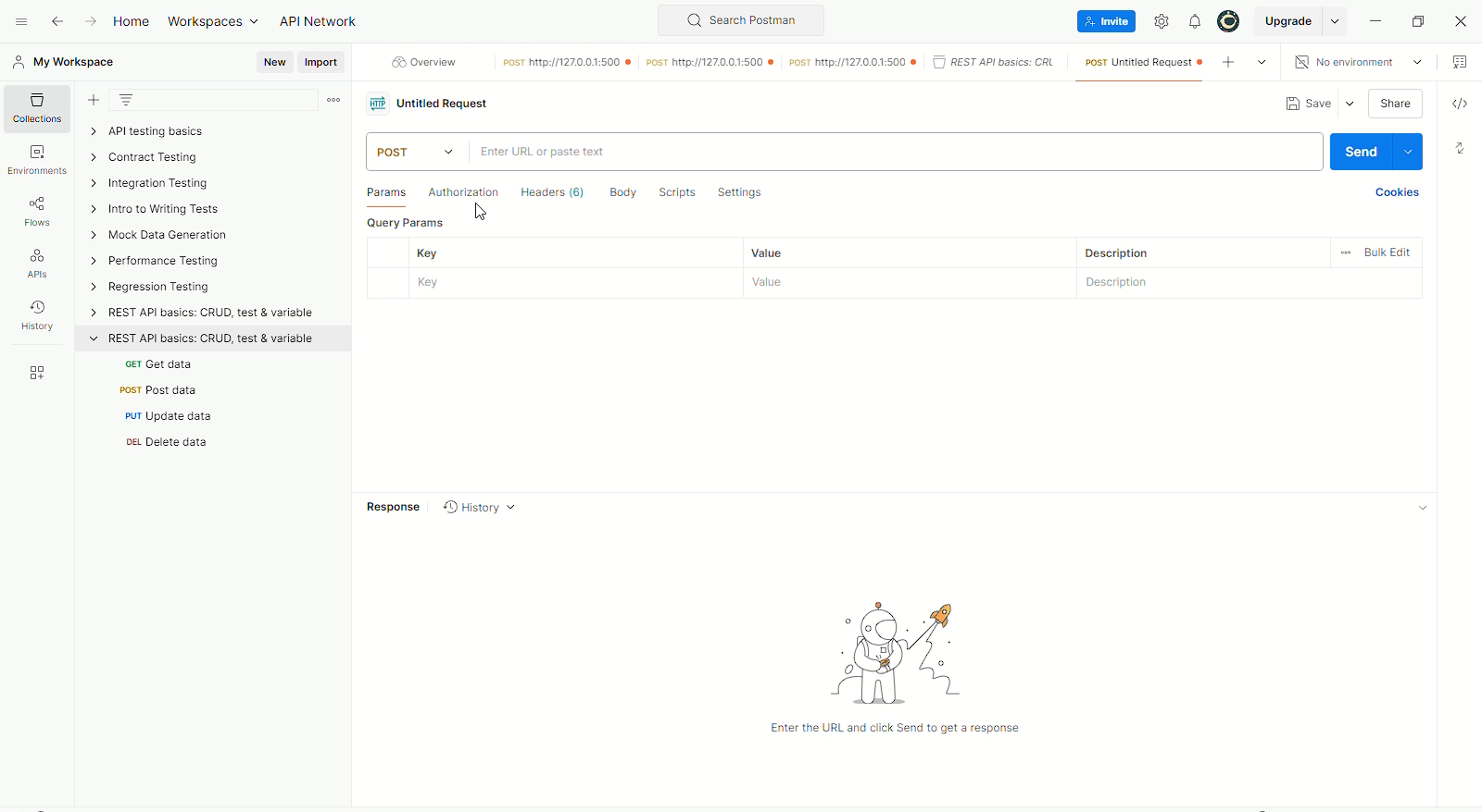
Video: Testing API using Postman

Slide 5
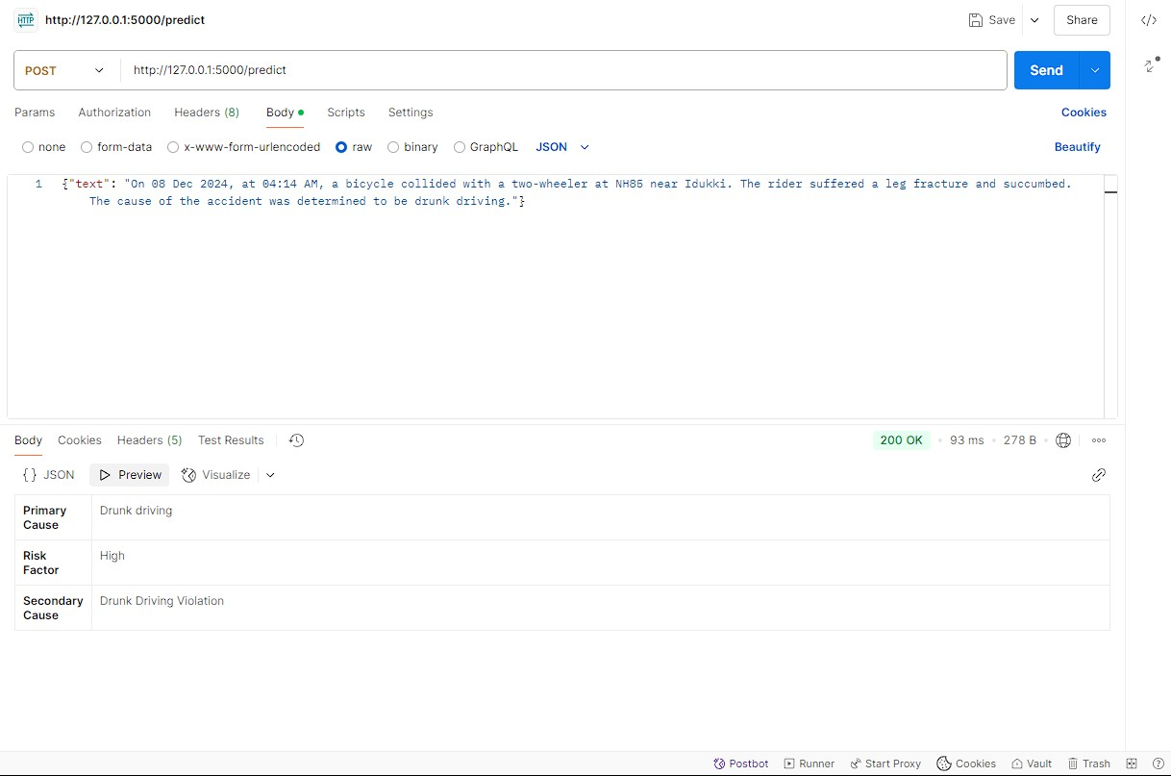
Image of output-Postman

Slide 6
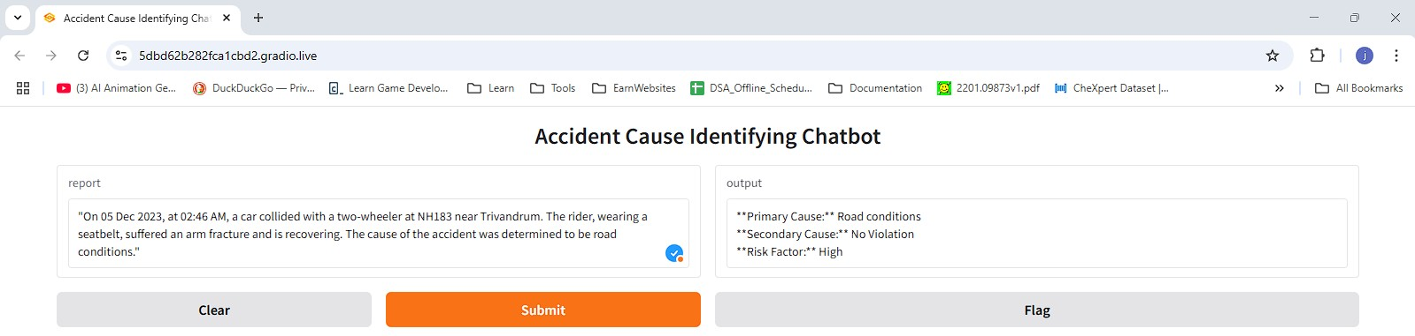
Accident cause identification chatbot (Using Gradio)

Slide 7
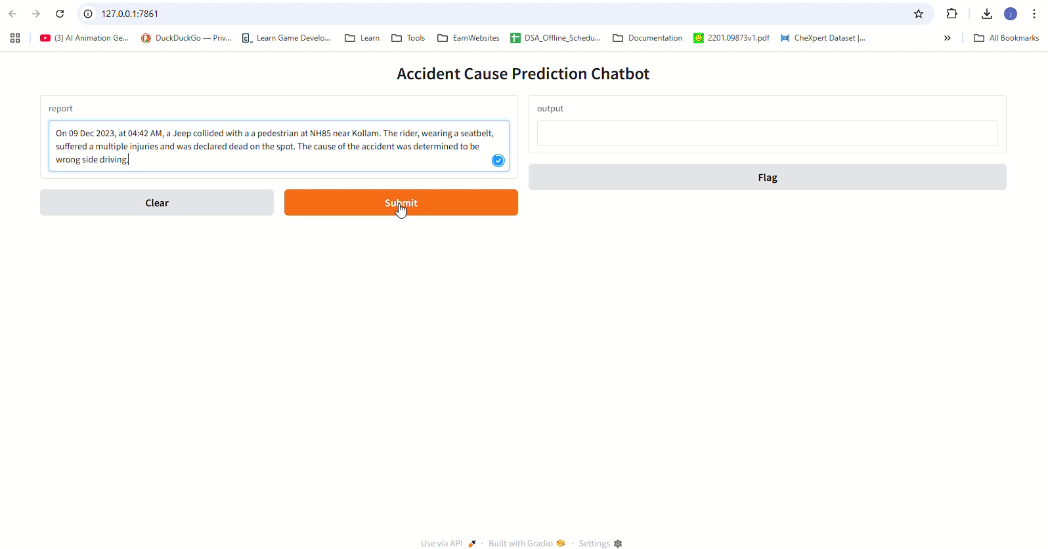
Video of chatbot: Gradio

Slide 8
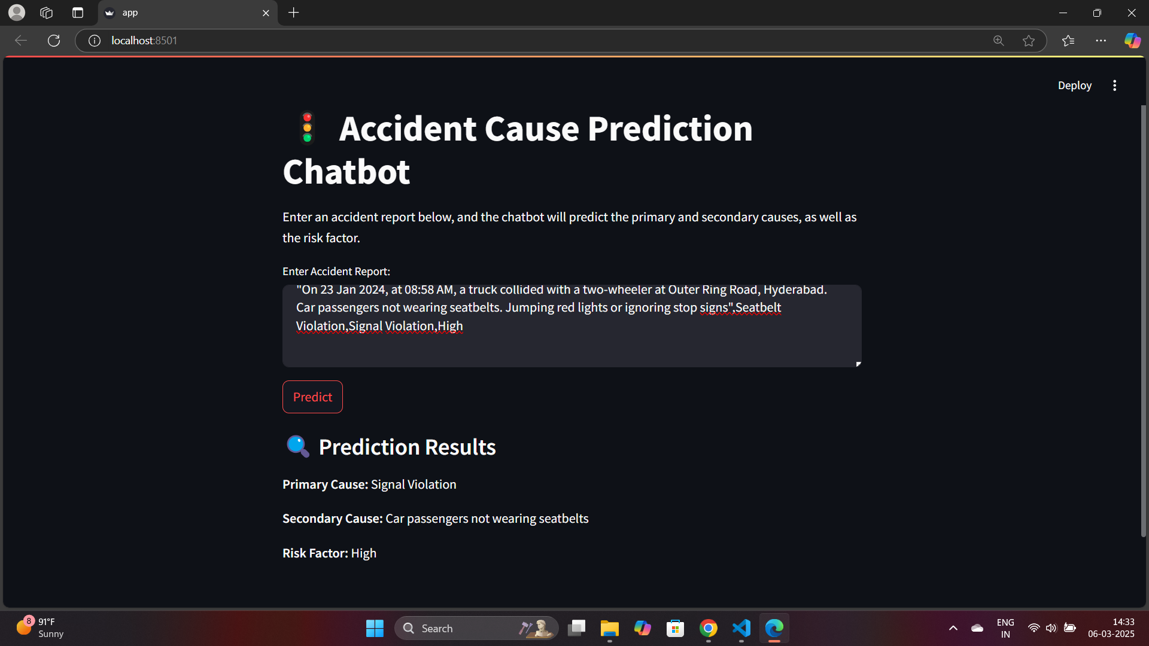
Chatbot(Using streamlit)

Slide 9
References
Form 54( Accident information report, Ministry of Road Transport and Highways)
Ministry of road transport and highways
iRAD (Integrated Road Accident Database)
Annual reports, GoI, Ministry of Road Transport and Highways
All India weather summary and forecast bulletin, India meteorological department
Postman documentation
Gradio documentation

